Slide 1
World Happiness Report: An Analysis of Economic, Social, and Governance Influences
Khandker M Qaiduzzaman

Slide 2
Abstract
Using information from the World Happiness Report, this project investigates the ways in which economic, social, and governance issues affect national happiness. Multiple linear regression analysis was used to determine the influence of important variables on happiness scores across nations, including GDP, social support, healthy life expectancy, freedom to make life choices, generosity, and perception of corruption. To find out if high-income countries are significantly happier than low-income ones, countries were also categorized by income level for hypothesis testing.
According to the regression model, GDP, health, social support, freedom, generosity, and corruption were all significant predictors. With a low p-value, a hypothesis test employing the permutation method verified a statistically significant difference between high and low- income groups.
The results imply that national circumstances and socioeconomic status both have a significant impact on happiness. Policymakers and development projects aimed at enhancing general well-being through financial and social investments can be guided by these ideas.

Slide 3
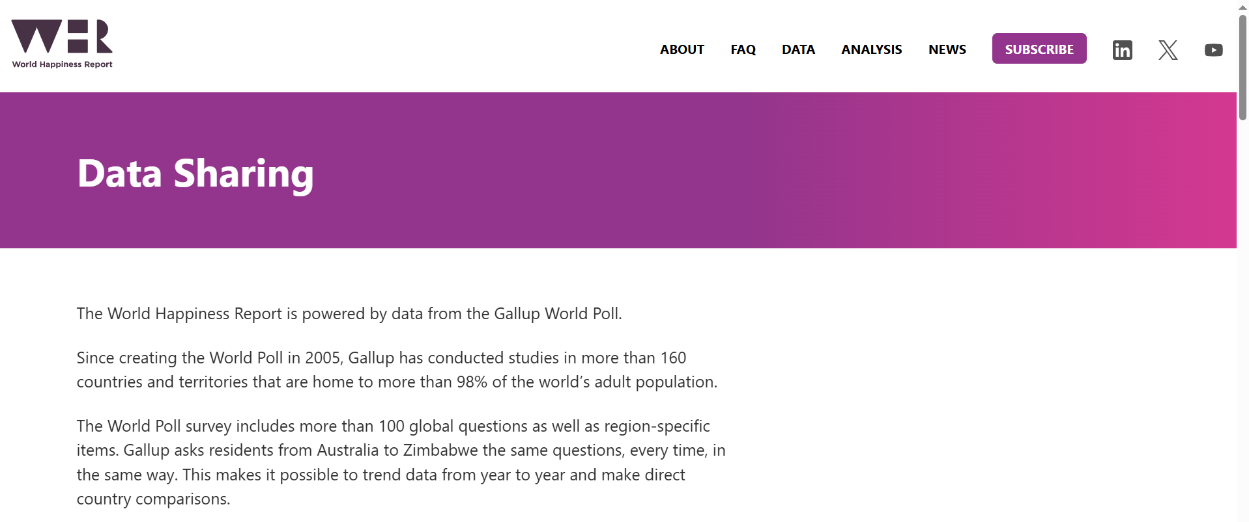
Data Collection
Gallup World Poll surveys are used to gather the data for the World Happiness Report, a project of the Sustainable Development Solutions Network (SDSN)
Data is compiled from a variety of sources, such as economic data, government documents, and polls that rely on perceptions
The data source is available at: https://worldhappiness.report/data-sharing/

Slide 4
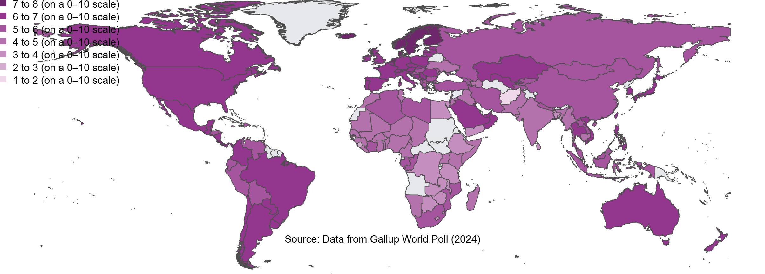
Dependent Variable: Ladder score (Happiness Score)
An individual's self-assessed rating of their current life on a scale from 0 (worst possible life) to 10 (best possible life), based on the Cantril ladder.

Slide 5
Independent Variables
Country name: List of the country involved
Year: Year the data was conducted
Rank: A country's position in the global happiness list based on its average life evaluation (Life Ladder) score for a given year
Log GDP per capita: Gross Domestic Product, or how much each country produces, divided by the number of people in the country. Information about the strength of a nation’s economy
Social support: Dependency on someone in times of trouble
Healthy life expectancy: Number of years an individual is expected to live in good health which combines both the length of life and the quality of life.
Freedom to make life choices: Right to life and liberty, freedom from slavery and torture, freedom of opinion and expression, the right to work and education
Generosity: Charity, donation and community engagement
Perception of corruption: The perception of government corruption, business corruption and individual corruption

Slide 6
Research Question
How do economic, social, and governance factors influence national happiness scores across countries?
Is there a significant difference in happiness scores between high-income and low-income countries?

Slide 7
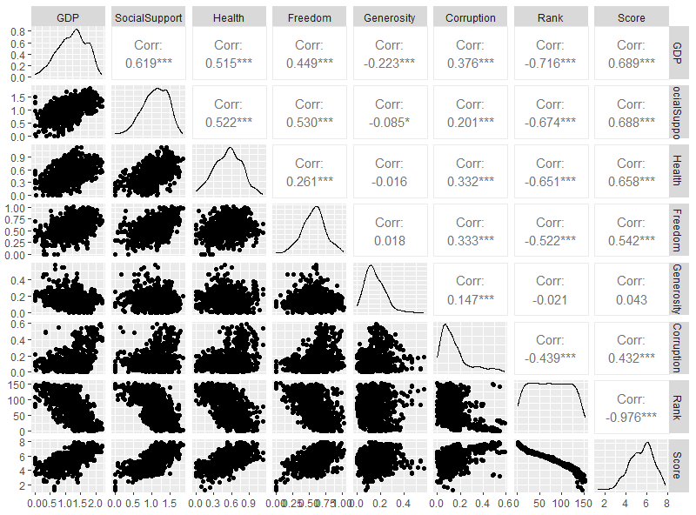
Correlation Matrix and Distribution

Slide 8
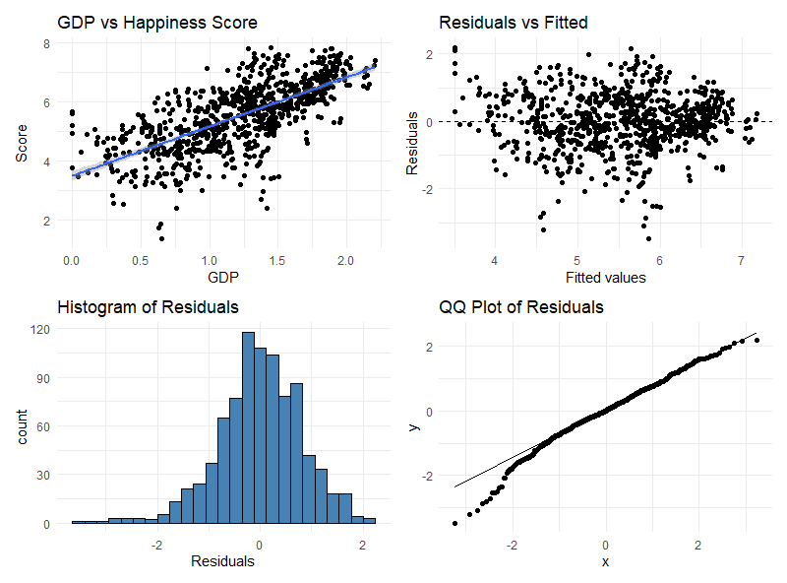
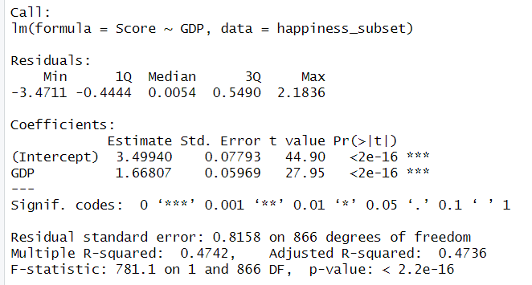

Linear Model Summary & Diagnosis: GDP vs. Happiness Score

Slide 9
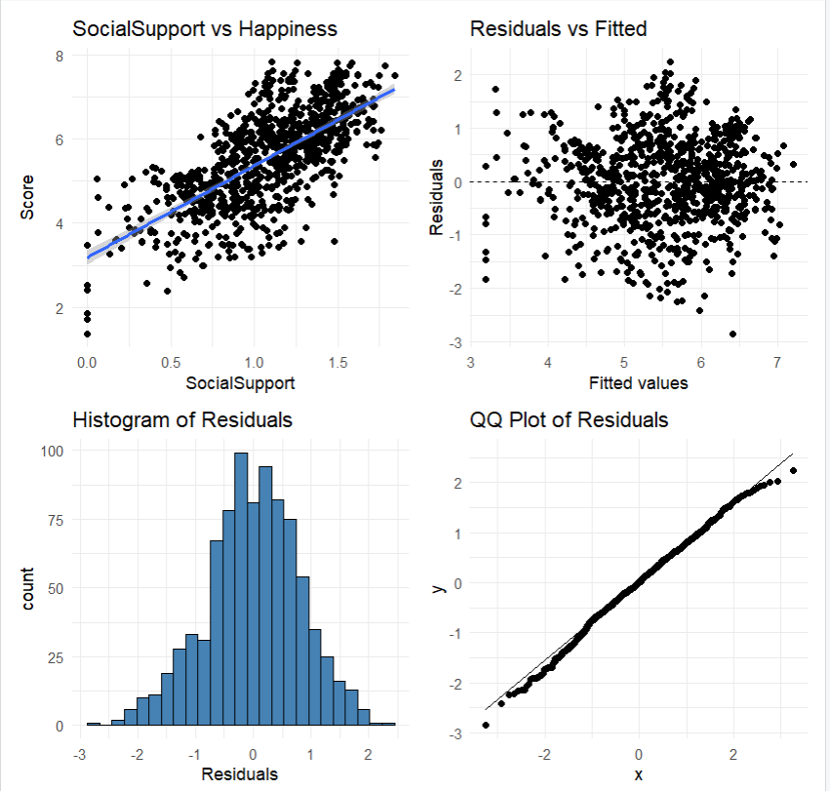
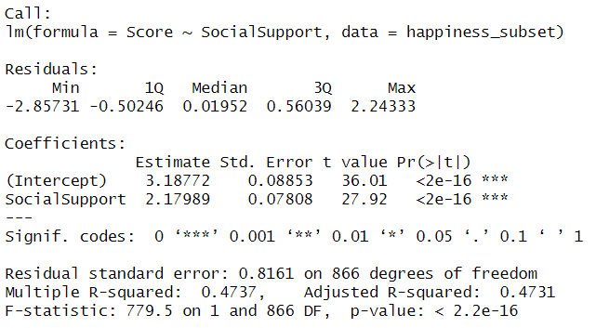

Linear Model Summary & Diagnosis: Social Support vs. Happiness Score

Slide 10
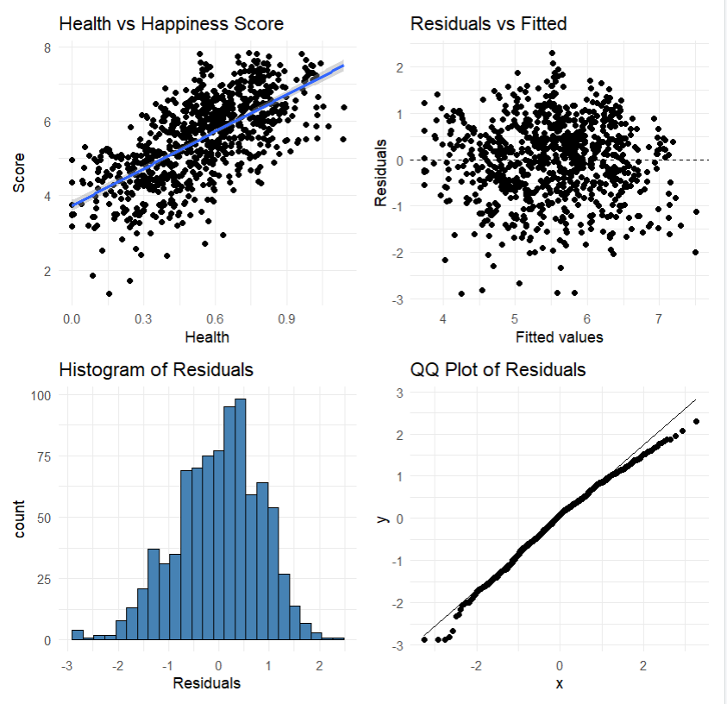
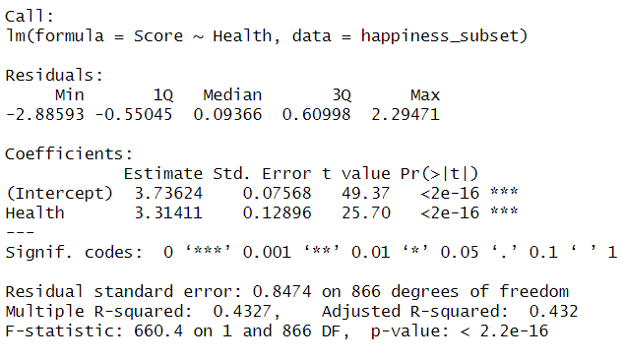

Linear Model Summary & Diagnosis: Health vs. Happiness Score

Slide 11
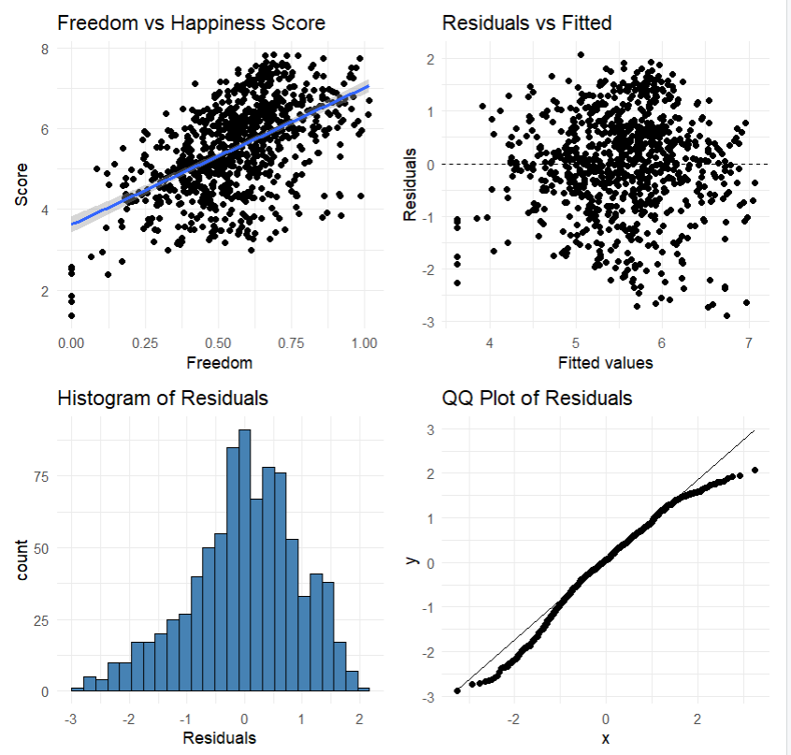
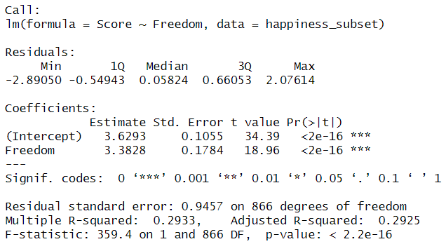

Linear Model Summary & Diagnosis: Freedom vs. Happiness Score

Slide 12
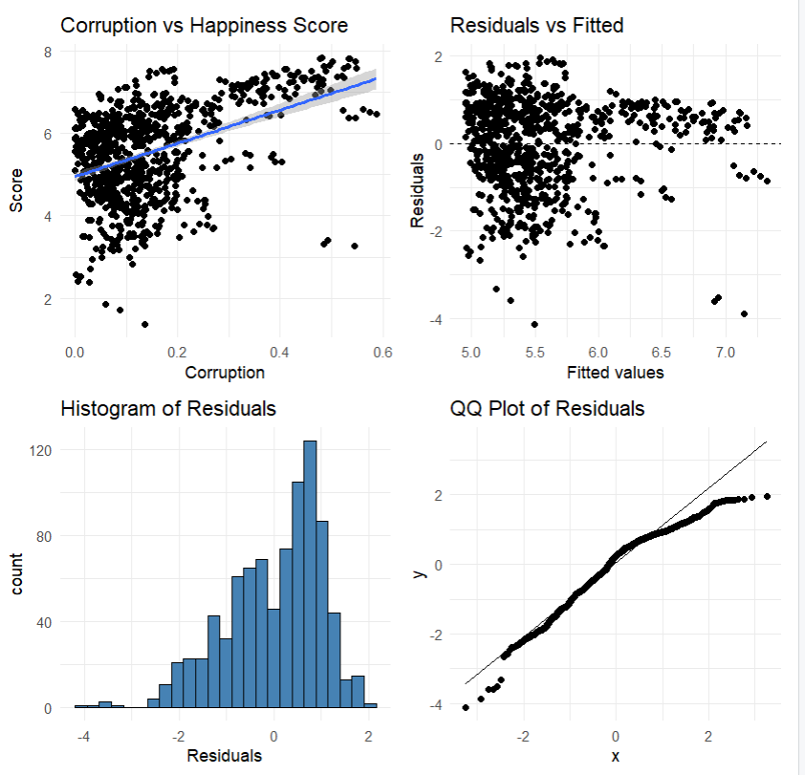
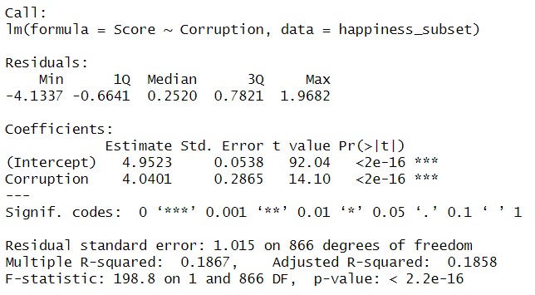

Linear Model Summary & Diagnosis : Corruption vs. Happiness Score

Slide 13
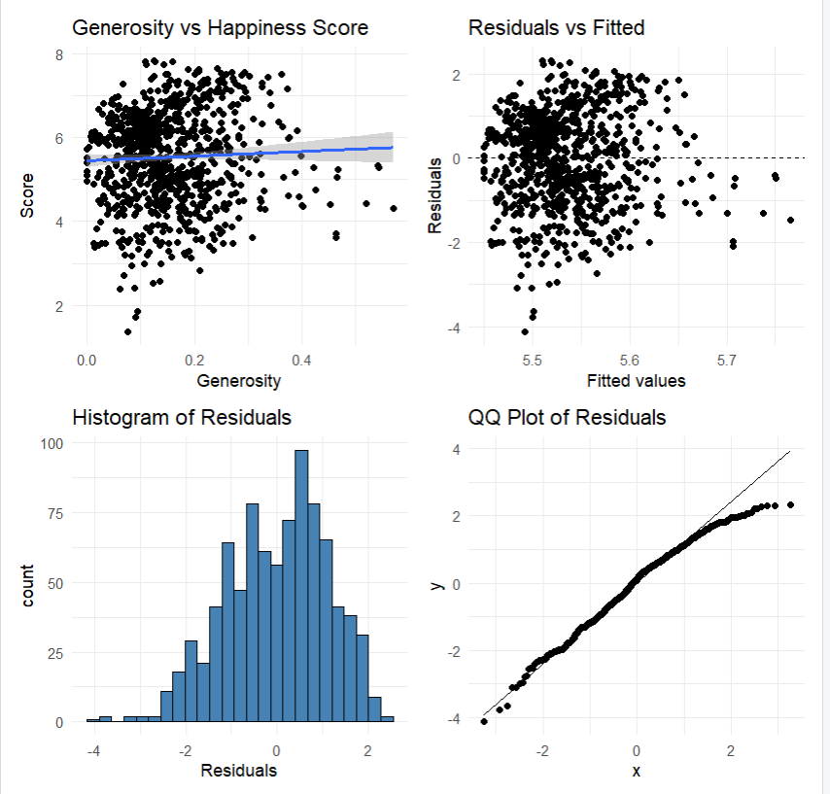
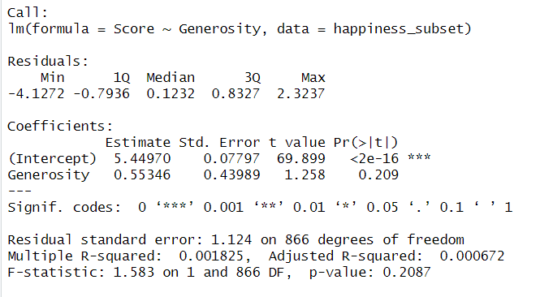

Linear Model Summary & Diagnosis: Generosity vs. Happiness Score

Slide 14
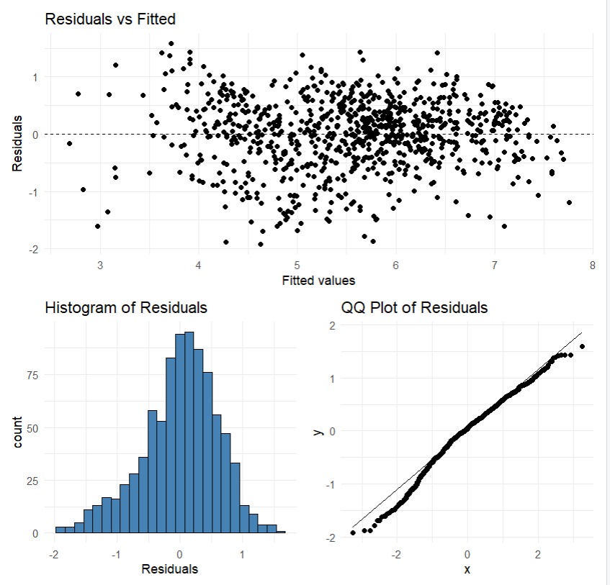
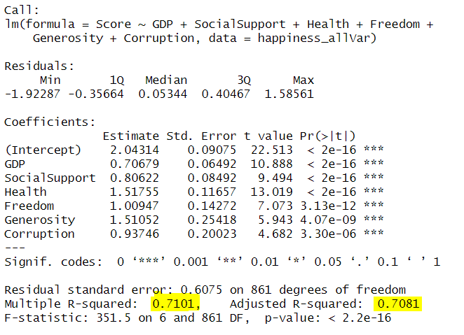
Multiple Linear Regression
About 70.81% of the variation in Happiness Scores across countries is explained by the independent variables- GDP, Social Support, Health, Freedom, Generosity, and Corruption

Slide 15
Most Significant Factors
Research Question 1: How do economic, social, and governance factors influence national happiness scores across countries?
Factors | Adjusted R-squared | Improvement
GDP | 0.4736 | -
GDP + Health | 0.5985 | 26.37%
GDP + Health + Freedom | 0.659 | 10.10%
GDP + Health + Freedom + Social Support | 0.684 | 3.79%
GDP + Health + Freedom + Social Support + Generosity | 0.701 | 2.49%
GDP + Health + Freedom + Social Support + Generosity + Corruption | 0.7081 | 1.01%

Slide 16
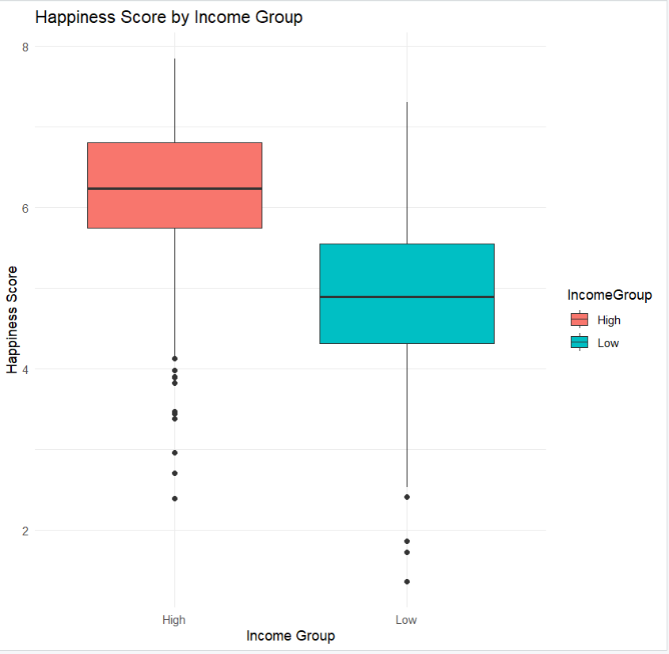
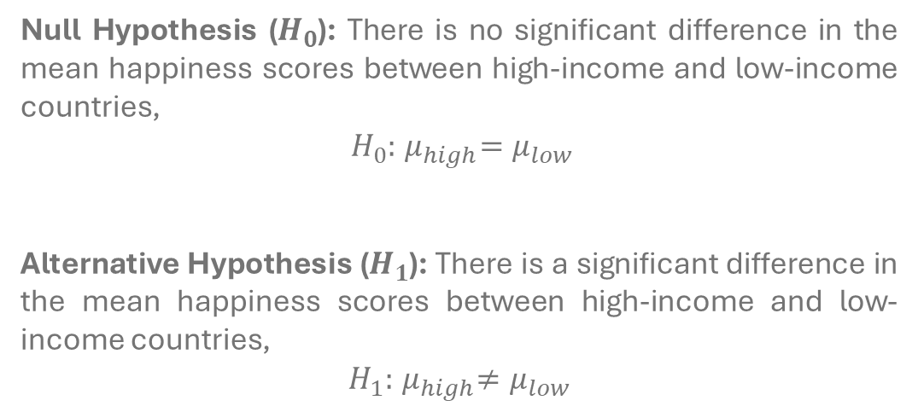
Research Question 2: Is there a significant difference in happiness scores between high-income and low-income countries?
Null Hypothesis ($H_{0}$): There is no significant difference in the mean happiness scores between high-income and low-income countries,
$H_{0}:{ μ}_{high}=μ_{low}$
Alternative Hypothesis ($H_{1}$): There is a significant difference in the mean happiness scores between high-income and low-income countries,
$$H_{1}:{ μ}_{high}≠μ_{low}$$

Slide 17
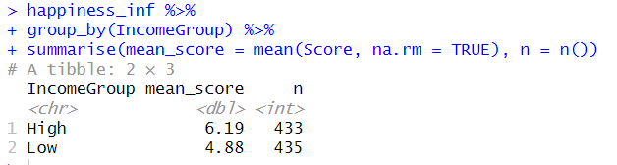
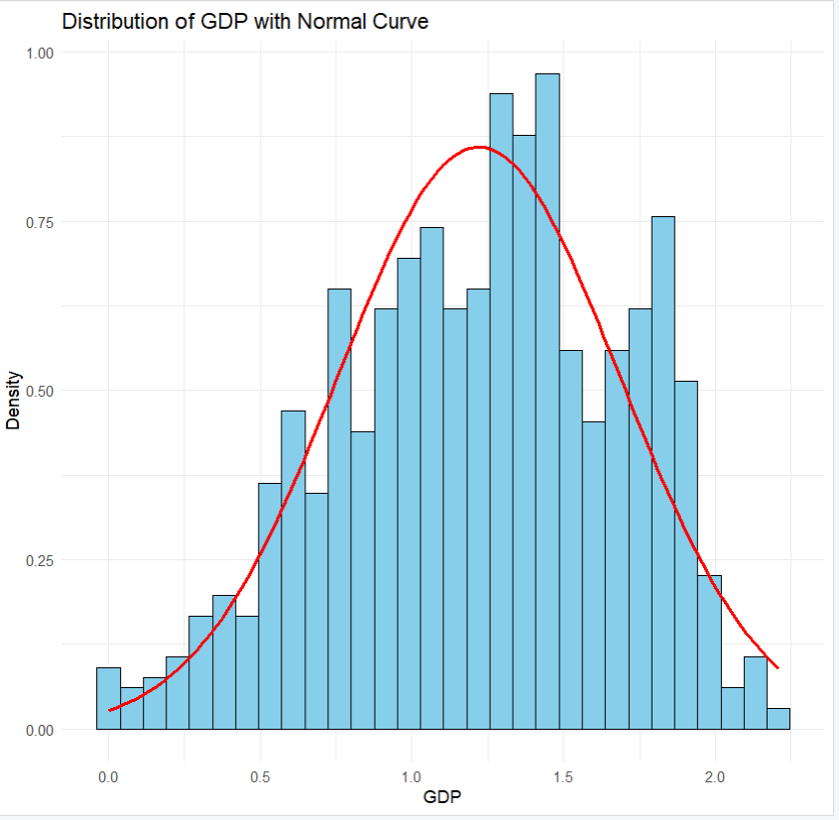
Conditions to Make Inference
Independence: we assume World Happiness Data collection method ensures independent sampling and the data has been collected randomly
Sample size: we can investigate the sample size using the following code. According to the income group sizes, the “High” and “Low” groups both have above 30 observations (433 and 435, respectively), meeting the sample size requirement
Normality: The distribution looks nearly normal

Slide 18
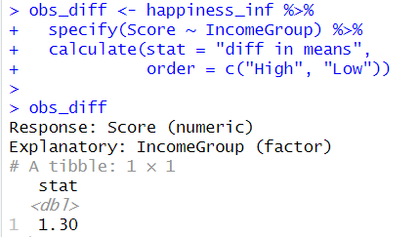
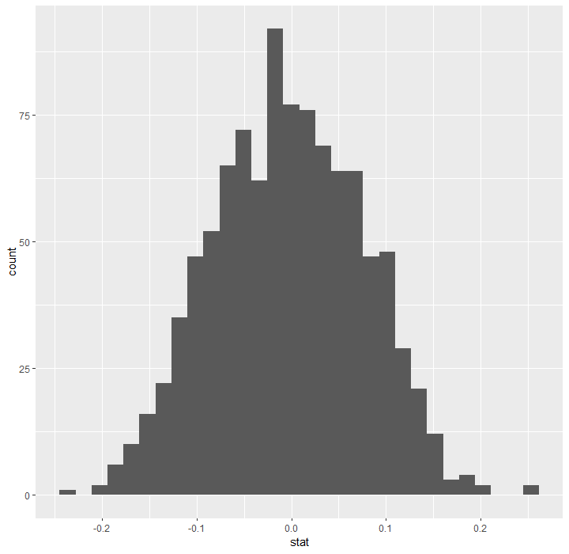
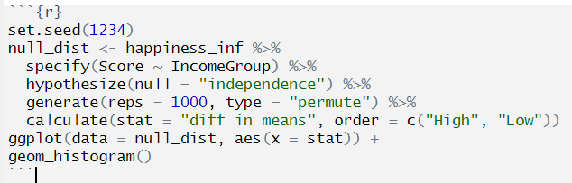

Calculating Observed Difference and Simulating the Test on Null Distribution
The observed difference is calculated as follows:
The null distribution is shown below:

Slide 19
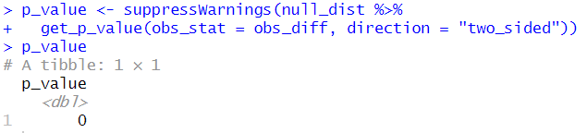

p-value
P-value calculation:
This strongly suggests that we reject the null hypothesis in favor of the alternative hypothesis, which implies that there is a significant difference in happiness scores between high-income and low-income countries.

Slide 20
Conclusion
This analysis is important because it-
shows how economic, social, and governance factors impact national well-being. About 71% of the variation in happiness scores is explained by GDP, Social Support, Health, Freedom, Generosity, and Corruption
confirms a significant disparity in happiness between high-income and low-income countries
The limitations of this analysis-
correlation does not imply causation. Correlation helps identify relationships (such as GDP vs. Score), but to prove causation- controlled experiments, longitudinal studies, strong theoretical backing, etc. are necessary
not all factors that affect happiness are included — like culture, religion, or political stability, etc.
a check for overfitting and underfitting is needed using methods like cross validation
a time series analysis could better capture changes in happiness over time, especially in response to major events like COVID-19

Slide 21
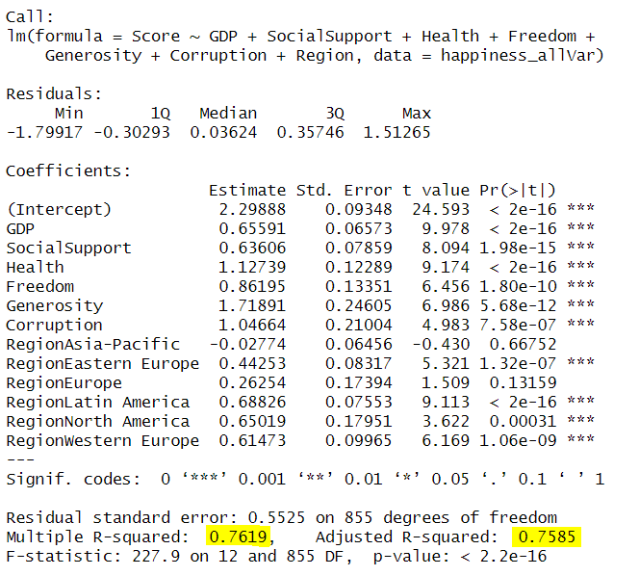
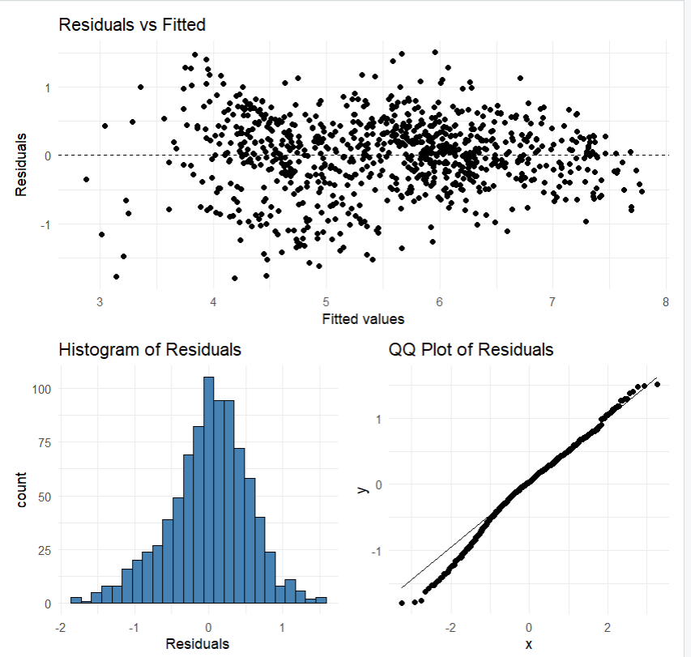




Appendix A: Adding Categorical Variable “Region” to the Model
Region data taken from: PhilippeCodes/World-Happiness-Report-Data-Analysis

Slide 22
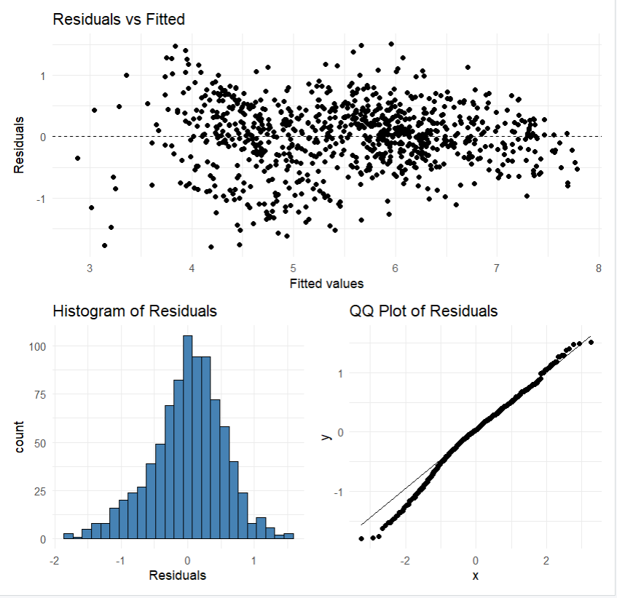
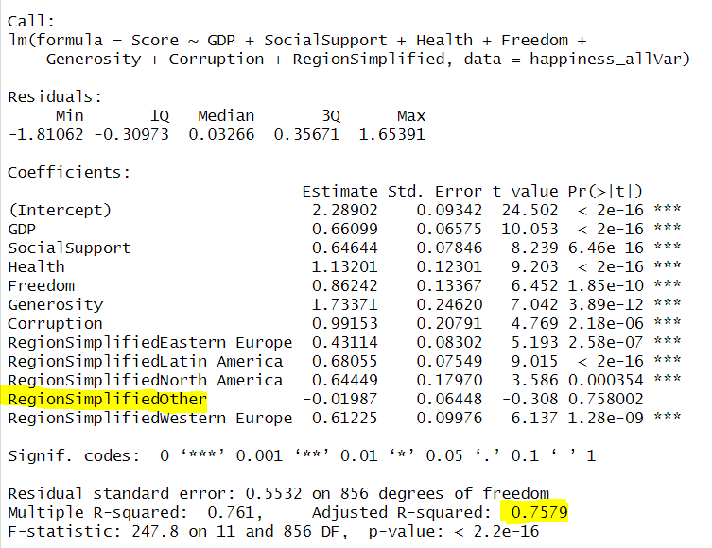
Appendix B: Dimensionality Reduction for Dummy Variable “Region”
Factors | Adjusted R-squared | Improvement
GDP | 0.4736 | -
GDP + Health | 0.5985 | 26.37%
GDP + Health + Freedom | 0.659 | 10.10%
GDP + Health + Freedom + Social Support | 0.684 | 3.79%
GDP + Health + Freedom + Social Support + Generosity | 0.701 | 2.49%
GDP + Health + Freedom + Social Support + Generosity + Corruption | 0.7081 | 1.01%
GDP + Health + Freedom + Social Support + Generosity + Corruption + Region Simplified | 0.7579 | 7.03%

Slide 23
Thank you!

